Slide 1

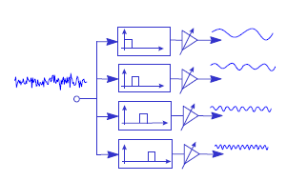
Digital Signal Processing
Course Instructor
Dr. Ali J. Abboud
Lecture No. 7: Digital Filters-FIR
Third Class
Department of Computers and Software Engineering
http://www.engineering.uodiyala.edu.iq/
https://www.facebook.com/Engineer.College1

Slide 2
Lecture Outline
Functions of Digital Filters.
Advantages and Disadvantages of Digital Filters.
Different Methods for Describing Digital Filters.
Classification of Digital Filters.
Filter Structures.
Types of Digital Filters.
Finite Impluse Response (FIR) Filters Design.
Dr. Ali J. Abboud

Slide 3
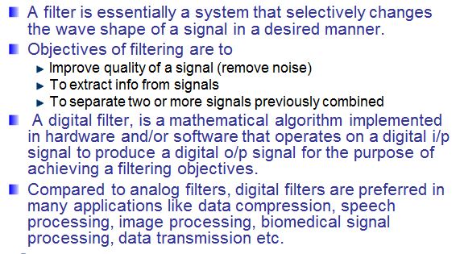
Digital Filters
Dr. Ali J. Abboud

Slide 4
Functions of Digital Filters
The primary functions of filters are one of the followings:
To confine a signal into a prescribed frequency band as in low-pass, high-pass, and band-pass filters.
(b) To decompose a signal into two or more sub-bands as in filter-banks, graphic equalizers, sub-band coders, frequency multiplexers.
(c) To modify the frequency spectrum of a signal as in telephone channel equalization and audio graphic equalizers.
(d) To model the input-output relationship of a system such as telecommunication channels, human vocal tract, and music synthesizers.
(e) To enhance or restore original by removing noise or distortion from corrupted signal.
Dr. Ali J. Abboud

Slide 5
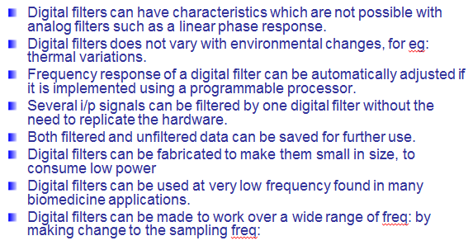
Advantages of Digital Filters
Dr. Ali J. Abboud

Slide 6
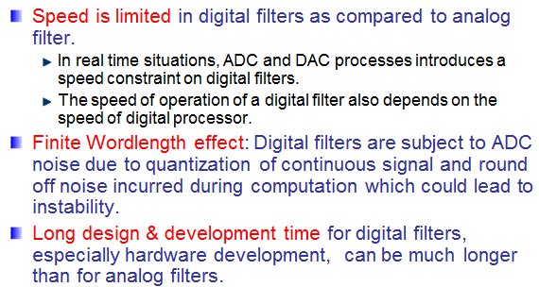
Disadvantages of Digital Filters
Dr. Ali J. Abboud

Slide 7
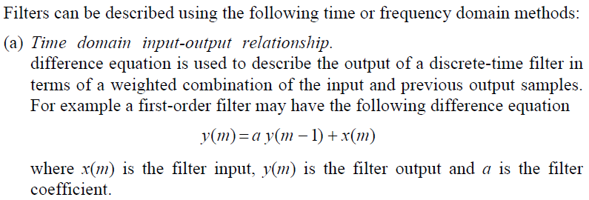
Different Methods for Describing of Digital Filters
Dr. Ali J. Abboud

Slide 8
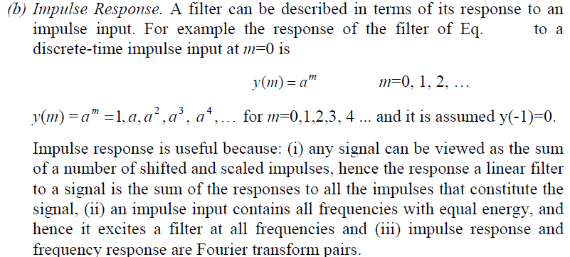
Different Methods for Describing of Digital Filters
Dr. Ali J. Abboud

Slide 9
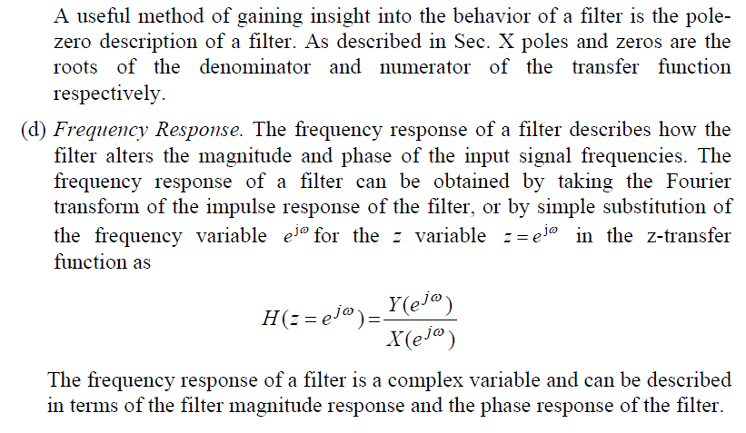
Different Methods for Describing of Digital Filters
Dr. Ali J. Abboud

Slide 10
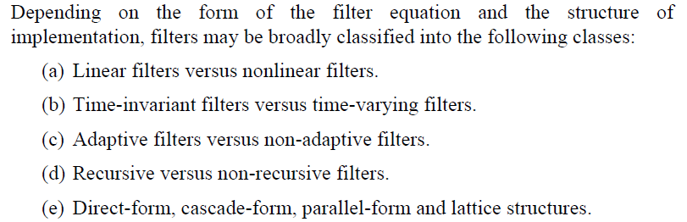
Classification of Digital Filters
Dr. Ali J. Abboud

Slide 11
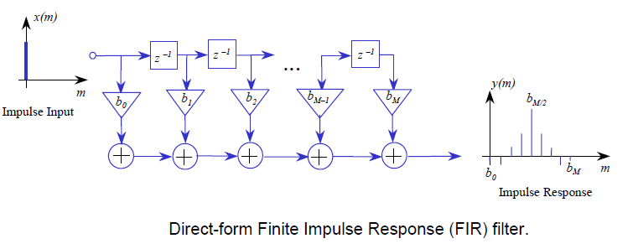
Filter Structures:
Direct, Cascade and Parallel Forms
We consider different structures for realization of a digital filter. These structures offer various trade-offs between complexity, cost of implementation, computational efficiency and stability.
1. Direct Filter Structure
Dr. Ali J. Abboud

Slide 12
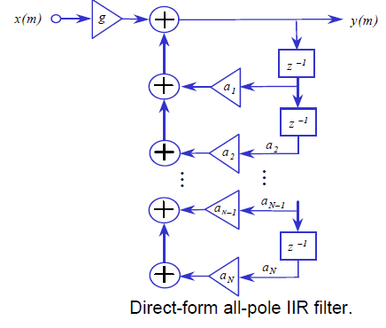
Filter Structures:
Direct, Cascade and Parallel Forms
1. Direct Filter Structure
Dr. Ali J. Abboud

Slide 13
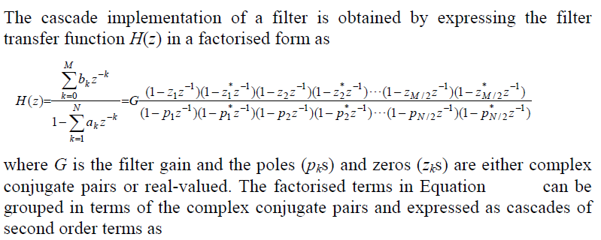
Filter Structures:
Direct, Cascade and Parallel Forms
2. Cascade Filter Structure
Dr. Ali J. Abboud

Slide 14
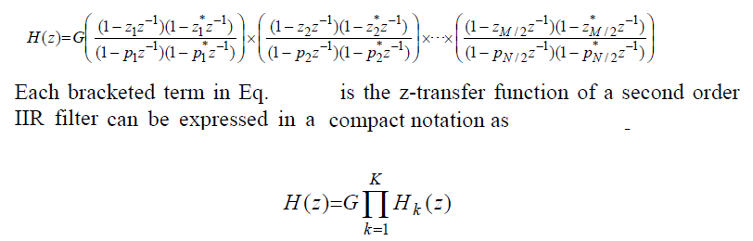
Filter Structures:
Direct, Cascade and Parallel Forms
2. Cascade Filter Structure
Dr. Ali J. Abboud

Slide 15
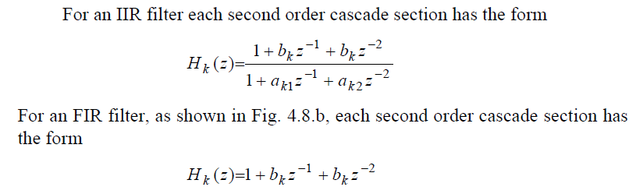
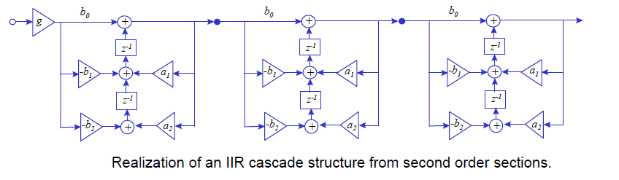
Filter Structures:
Direct, Cascade and Parallel Forms
2. Cascade Filter Structure
Dr. Ali J. Abboud

Slide 16
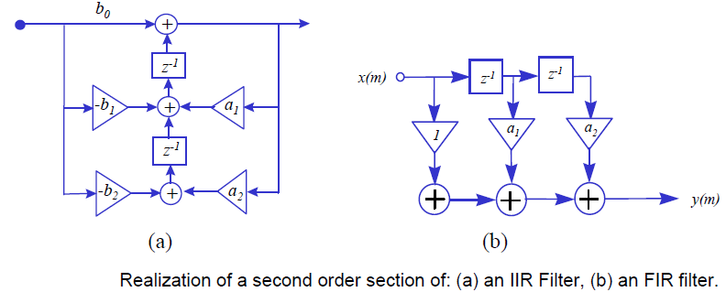
Filter Structures:
Direct, Cascade and Parallel Forms
2. Cascade Filter Structure
Dr. Ali J. Abboud

Slide 17
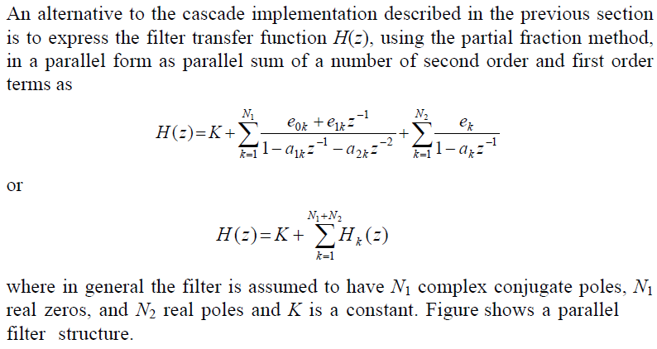
Filter Structures:
Direct, Cascade and Parallel Forms
3. Parallel Filter Structure
Dr. Ali J. Abboud

Slide 18
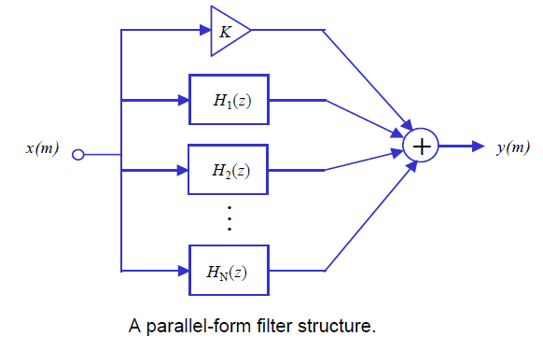
Filter Structures:
Direct, Cascade and Parallel Forms
3. Parallel Filter Structure
Dr. Ali J. Abboud

Slide 19
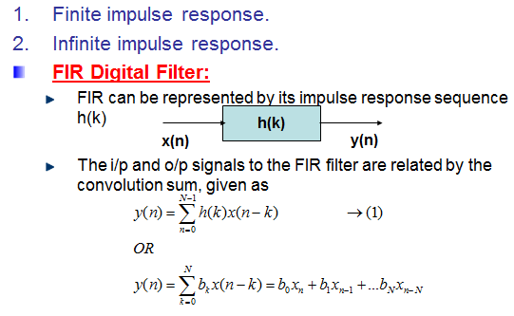
Types of Digital Filters
Dr. Ali J. Abboud

Slide 20
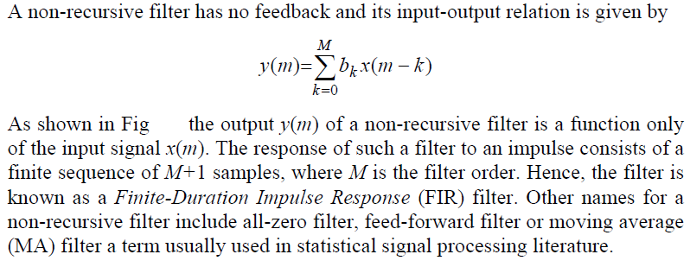
Types of Digital Filters
Dr. Ali J. Abboud

Slide 21
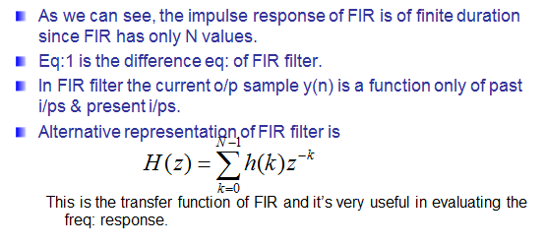
Types of Digital Filter
Dr. Ali J. Abboud

Slide 22
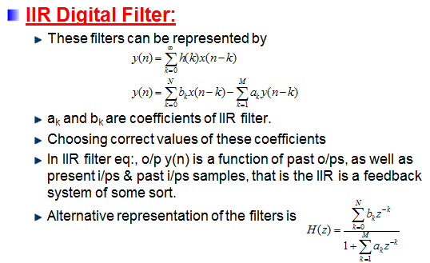
Types of Digital Filters
Dr. Ali J. Abboud

Slide 23
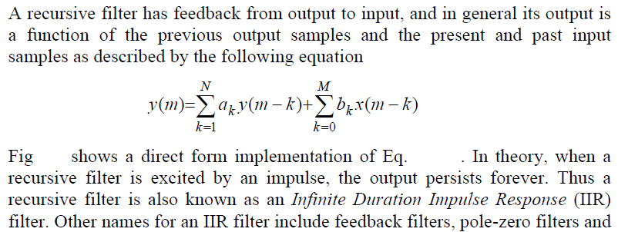
Types of Digital Filters
Dr. Ali J. Abboud

Slide 24
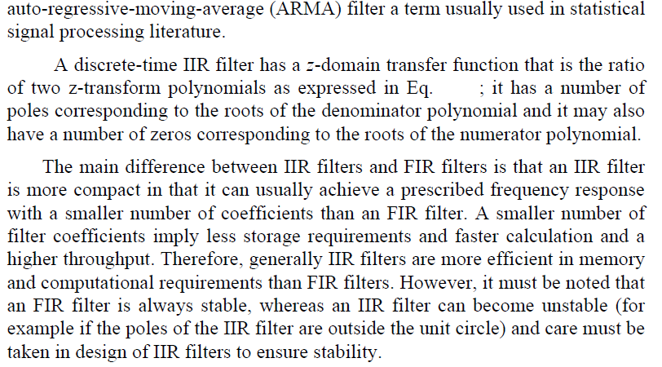
Types of Digital Filters
Dr. Ali J. Abboud

Slide 25
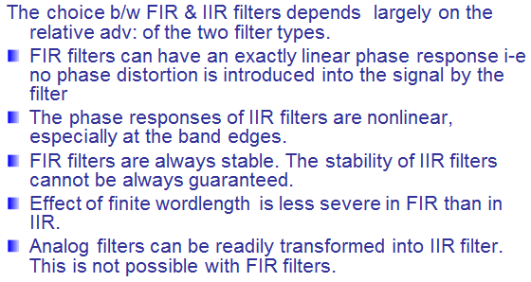
Choosing Between IIR and FIR Filters
Dr. Ali J. Abboud

Slide 26
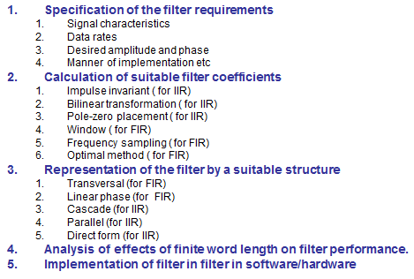
Filter Design Steps
Dr. Ali J. Abboud

Slide 27
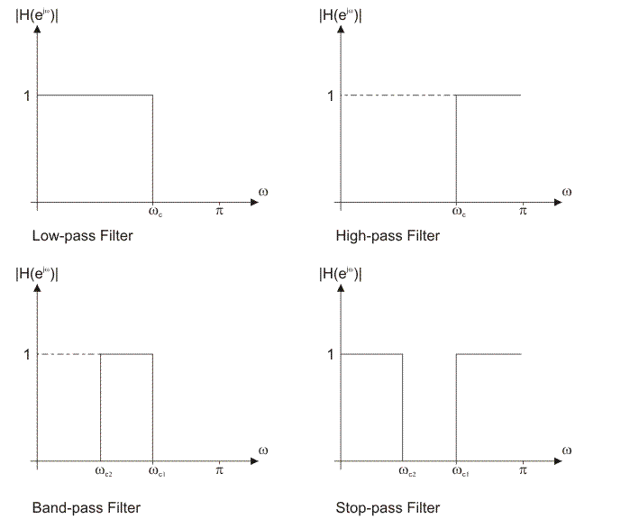
Kinds of Filters
Dr. Ali J. Abboud

Slide 28
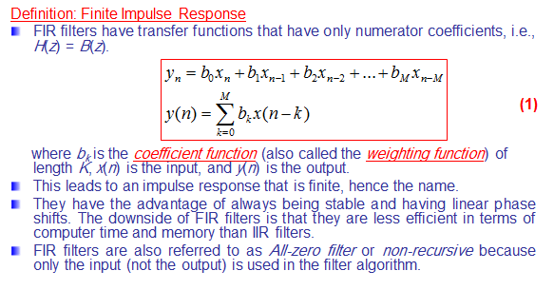
Finite Impulse Response (FIR) Filters
Dr. Ali J. Abboud

Slide 29
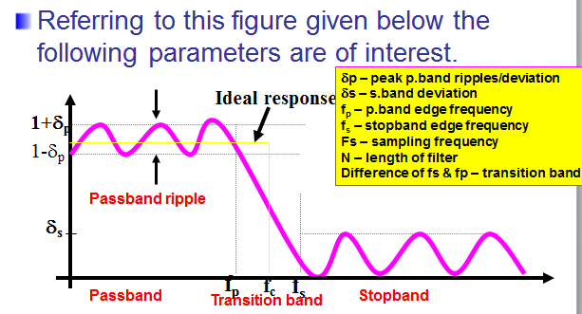
STEP1:FIR Filter Specification
Dr. Ali J. Abboud

Slide 30
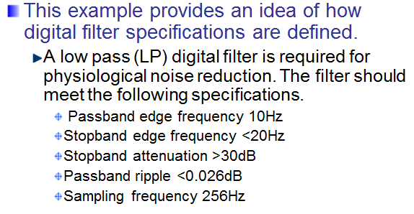
Specification Example
Dr. Ali J. Abboud

Slide 31
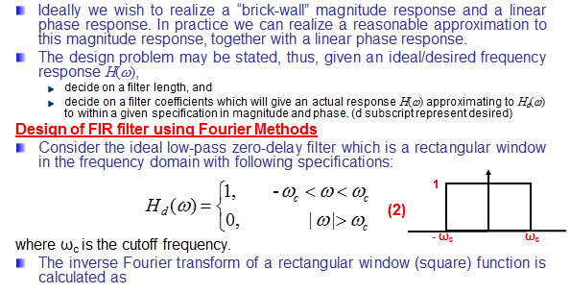
Step 2: Calculation of Suitable
Filter Coefficients
Dr. Ali J. Abboud

Slide 32
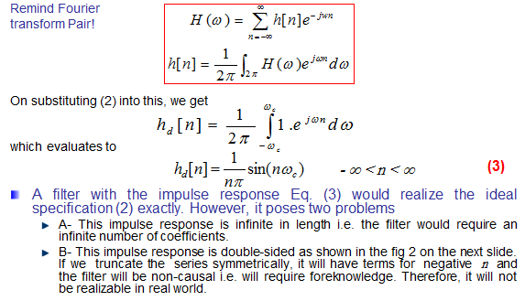
Design of FIR filter using Fourier Methods
Dr. Ali J. Abboud

Slide 33
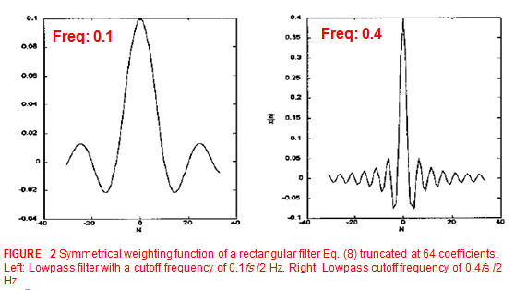
Design of FIR filter using Fourier Methods
Dr. Ali J. Abboud

Slide 34
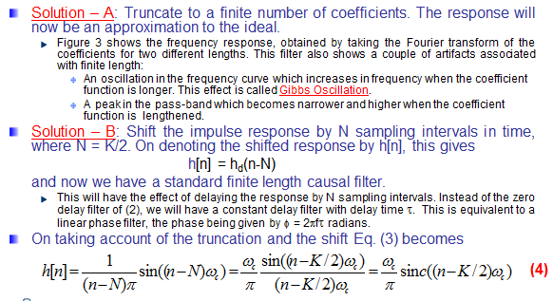
Design of FIR filter using Fourier Methods
Dr. Ali J. Abboud

Slide 35
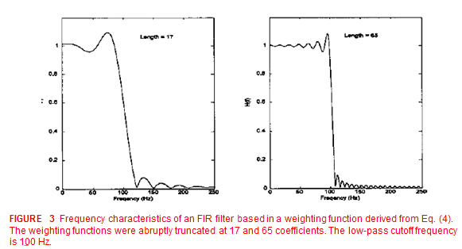
Artifacts of Truncation
Dr. Ali J. Abboud

Slide 36
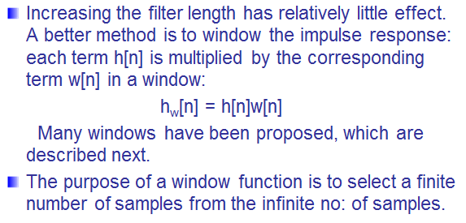
Reducing the Effect of Truncation
Dr. Ali J. Abboud

Slide 37
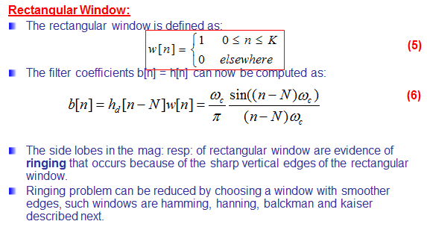
Designing FIR Filters: Windows
Dr. Ali J. Abboud

Slide 38
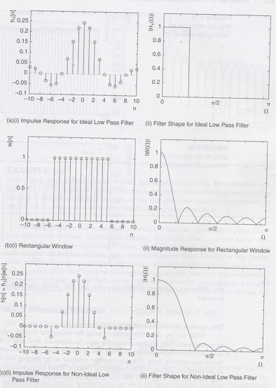
Windows Method
Dr. Ali J. Abboud

Slide 39
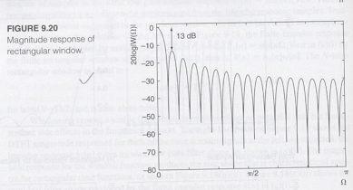
Windows Method
Dr. Ali J. Abboud

Slide 40
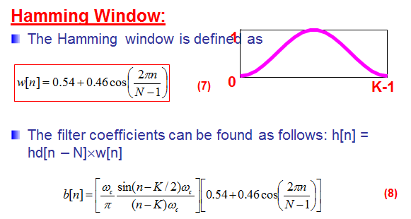
Hamming Window
Dr. Ali J. Abboud

Slide 41
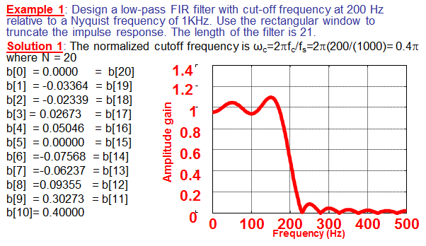
Example1
Dr. Ali J. Abboud

Slide 42
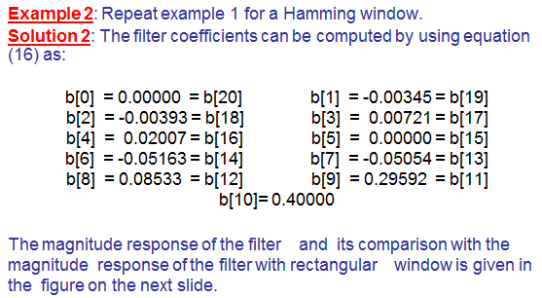
Example2
Dr. Ali J. Abboud

Slide 43
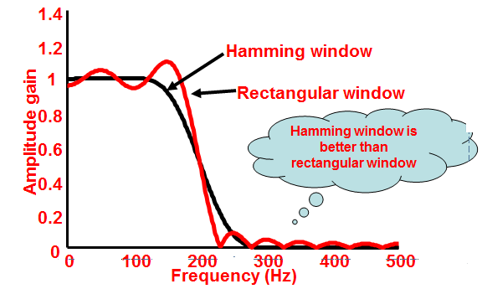
Hamming Window
Dr. Ali J. Abboud

Slide 44
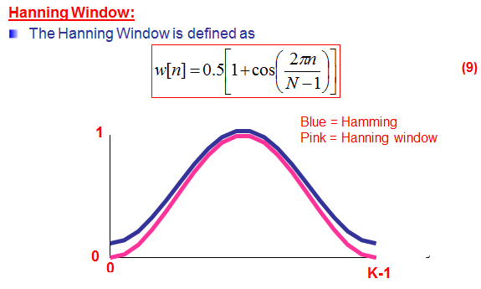
Hanning Window
Dr. Ali J. Abboud

Slide 45
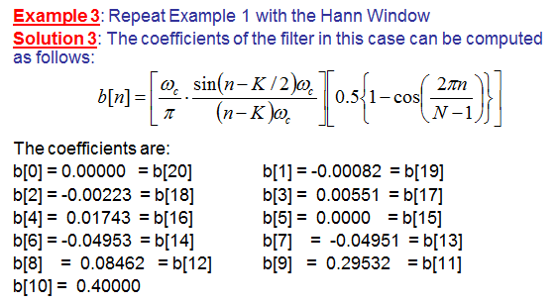
Hanning Window: Example3
Dr. Ali J. Abboud

Slide 46
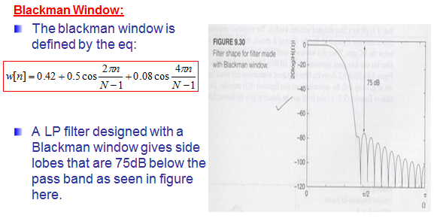
Blackman Window
Dr. Ali J. Abboud

Slide 47
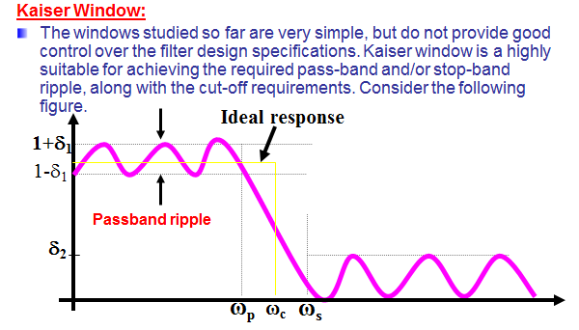
Kaiser Window
Dr. Ali J. Abboud

Slide 48
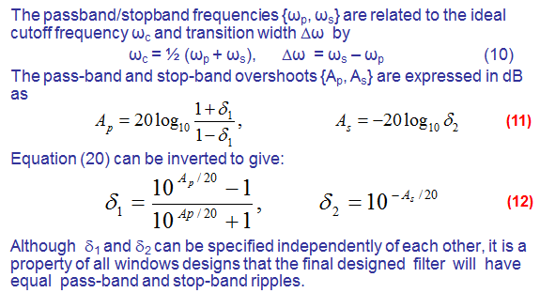
Kaiser Window
Dr. Ali J. Abboud

Slide 49
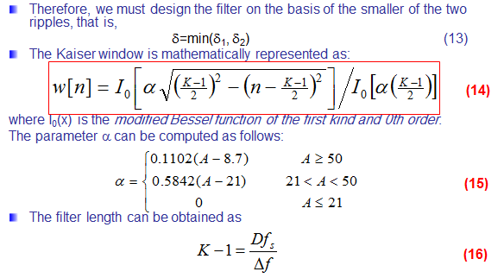
Kaiser Window
Dr. Ali J. Abboud

Slide 50
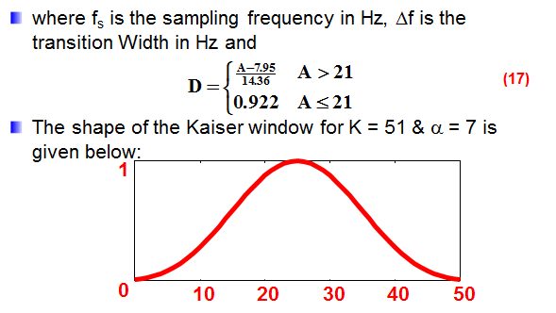
Kaiser Window
Dr. Ali J. Abboud

Slide 51
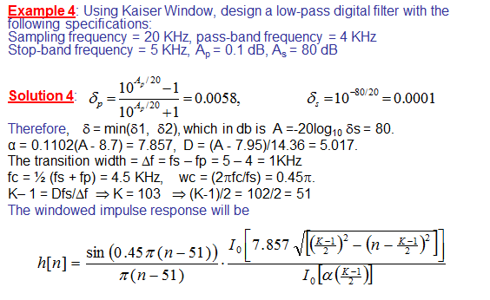
Kaiser Window: Example
Dr. Ali J. Abboud

Slide 52

Summary of Windows
Dr. Ali J. Abboud

Slide 53

Example
Dr. Ali J. Abboud

Slide 54

Choosing Window Type
Dr. Ali J. Abboud

Slide 55

Steps for LP FIR filter design
Dr. Ali J. Abboud

Slide 56

Example
Dr. Ali J. Abboud

Slide 57

Example
Dr. Ali J. Abboud

Slide 58

Example
Dr. Ali J. Abboud

Slide 59

BP and HP FIR Filters
Dr. Ali J. Abboud

Slide 60


BP and HP FIR Filters
Dr. Ali J. Abboud

Slide 61

BP and HP FIR Filters
Dr. Ali J. Abboud

Slide 62

Band stop FIR Filters
Dr. Ali J. Abboud

Slide 63

Band stop FIR Filters
Dr. Ali J. Abboud

Slide 64

Band stop FIR Filters
Dr. Ali J. Abboud

Slide 65

Another method for designing
HP,BP & BS FIR filters
Dr. Ali J. Abboud

Slide 66

Generalized FIR Filter design
Dr. Ali J. Abboud

Slide 67

Example
Dr. Ali J. Abboud

Slide 68

Example
Dr. Ali J. Abboud

Slide 69

Generalized FIR Filter design
Dr. Ali J. Abboud

Slide 70

Example
Dr. Ali J. Abboud

Slide 71


Optimal Method
Figure: a , b
Dr. Ali J. Abboud

Slide 72

Optimal Method
Dr. Ali J. Abboud

Slide 73

Optimal Method
Dr. Ali J. Abboud

Slide 74

Optimal Method
Dr. Ali J. Abboud

Slide 75

Steps of procedure for calculating filter coefficients by Optimal method.
Dr. Ali J. Abboud

Slide 76

Example
Dr. Ali J. Abboud

Slide 77

Example
Dr. Ali J. Abboud

Slide 78


Example
Dr. Ali J. Abboud

Slide 79

Frequency sampling method
Dr. Ali J. Abboud

Slide 80


Realization Structures for FIR Filters
Dr. Ali J. Abboud

Slide 81

Linear Phase Structure
Dr. Ali J. Abboud

Slide 82



Linear Phase Structure: Example
Dr. Ali J. Abboud

Slide 83

Finite Word length effects in FIR filters
Dr. Ali J. Abboud

Slide 84

FIR Implementation Techniques
Dr. Ali J. Abboud

Slide 85
End of Chapter
Dr. Ali J. Abboud

